Slide 1

CSC3170
Tutorial 11
School of Data Science
The Chinese University of Hong Kong, Shenzhen

Slide 2
Overview
Query Optimization
Heuristics
  Relational Algebra Equivalences
  Logical Query Optimization
  Nested Queries
  Expression Rewriting
Exercise
2

Slide 3
Why we need Query Optimization
Remember that SQL is declarative.
--User tells the DBMS what answer they want, not how to get the answer.
There can be a big difference in performance based on plan is used

Slide 4
Heuristics / Rules
--Rewrite the query to remove stupid / inefficient things.
--These techniques may need to examine catalog, but they do not need to examine data.
Cost-based Search
--Use a model to estimate the cost of executing a plan.
--Evaluate multiple equivalent plans for a query and pick the one with the lowest cost.

Slide 5
A DBMS can use Heuristics/Rules to transform relational algebra expressions into equivalent expressions with lower costs, thereby achieving query optimization. These rules are typically applied to all queries. For example:
Predicate Pushdown
Projections Pushdown
Nested Query Rewriting
Expression Rewriting
……

Slide 6
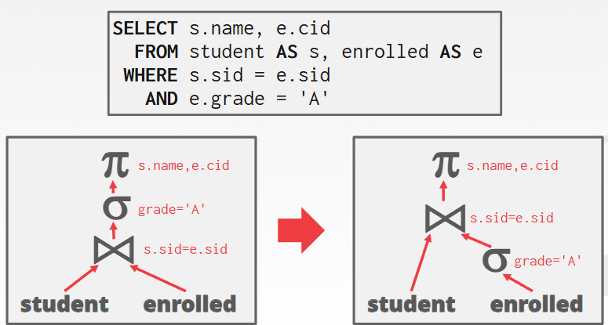
Predicate Pushdown

Slide 7
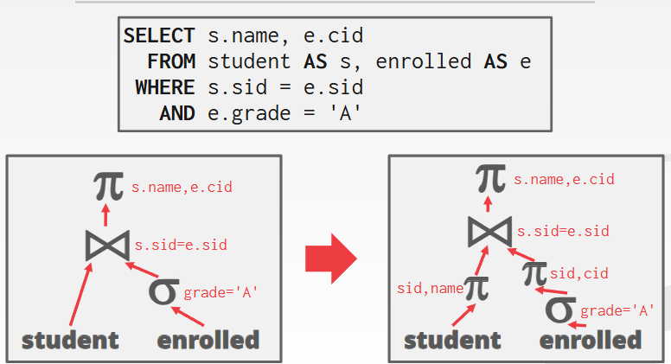
Projections Pushdown

Slide 8
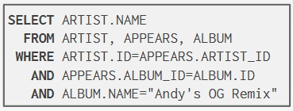
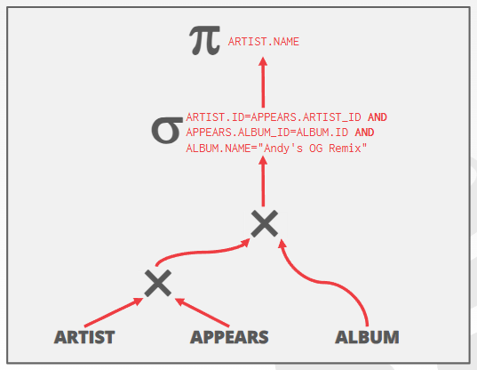
Decompose predicates into their
simplest forms
Move the predicate to the lowest
applicable point in the plan.

Slide 9
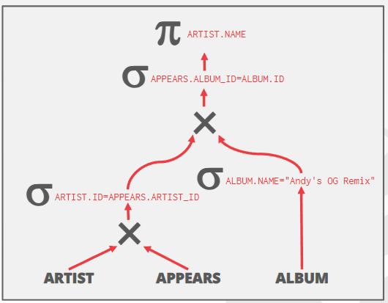
Replace all Cartesian Products
with inner joins using the join
predicates.

Slide 10
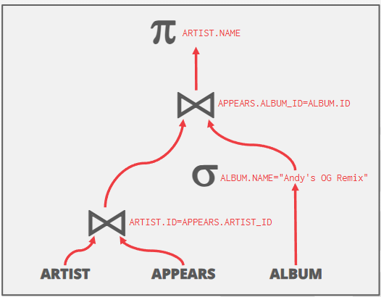
Eliminate redundant attributes
before pipeline breakers to
reduce materialization cost.

Slide 11
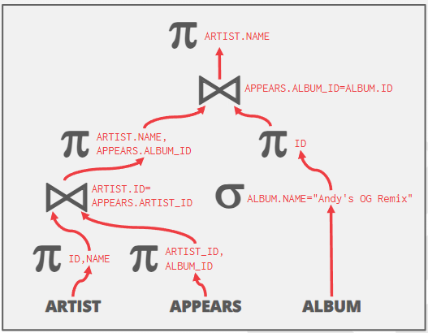
Eliminate redundant attributes
before pipeline breakers to
reduce materialization cost.

Slide 12
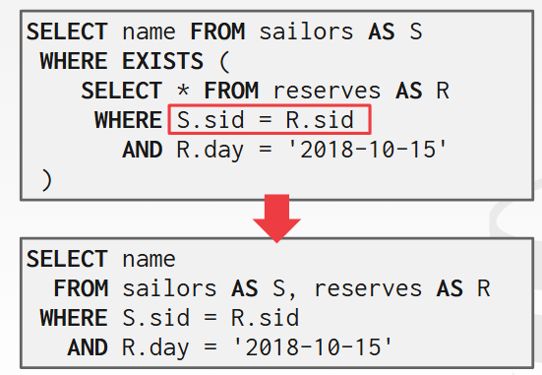
Nested Query Rewrite

Slide 13
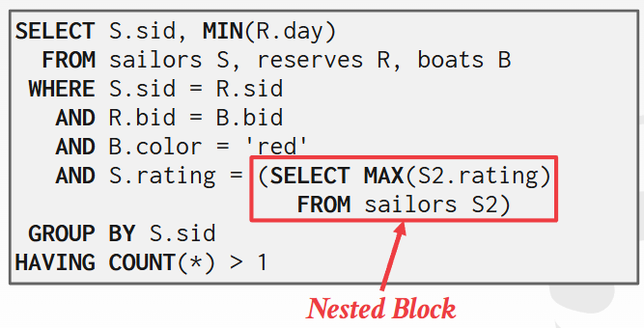
Nested Query Decompose

Slide 14
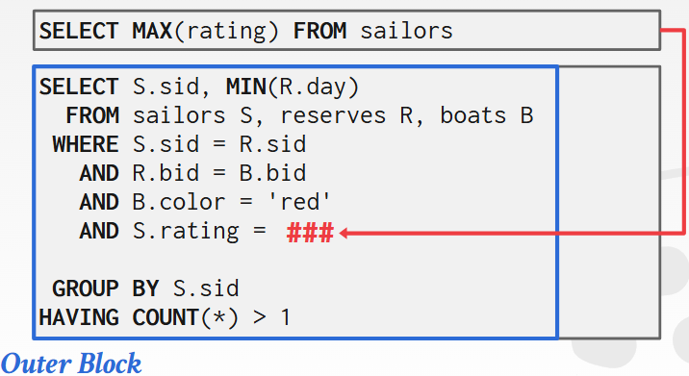
Nested Query Decompose

Slide 15

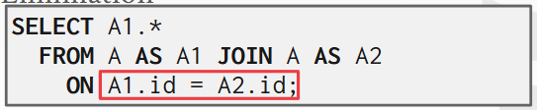
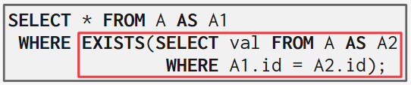
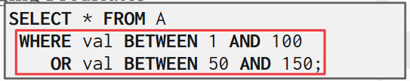

Expression Rewrite
Impossible/Unnecessary predicate
Join estimate
Predicates merge

Slide 16
Exercise

Slide 17
For the student-course database, query the names of all courses taken by students in the Faculty of Computer Science:
Select Cname
From Student, Course, Score
Where Student.Sno=Score.Sno and Score.Cno=Course.Cno and Student.Sdept=“CS"
Draw the syntax tree and optimize the syntax tree with relational algebra and draw the optimized syntax tree

Slide 18




$$π_{Cname}$$
Select Cname
From Student, Course, Score
Where Student.Sno=Score.Sno and
Score.Cno=Course.Cno and
Student.Sdept=“CS"
$$σ_{Student.Sno=Score.sno}$$
$$σ_{Score.Cno=Course.Cno}$$
$$σ_{Student.Sdept="CS"}$$
1.Predicate Pushdown.
2.Replacing the Cartesian product using Inner join.
3.Projection Pushdown.
$$×$$
$$×$$
Course
Student
Score

Slide 19




Select Cname
From Student, Course, Score
Where Student.Sno=Score.Sno and
Score.Cno=Course.Cno and
Student.Sdept=“CS"
$$π_{Cname}$$
$$σ_{Score.Cno=Course.Cno}$$
$$×$$
$$σ_{Student.Sno=Score.sno}$$
Course
$$×$$
$$σ_{Student.Sdept="CS"}$$
Score
Student

Slide 20




Select Cname
From Student, Course, Score
Where Student.Sno=Score.Sno and
Score.Cno=Course.Cno and
Student.Sdept=“CS"
$$π_{Cname}$$
$$⋈_{Score.Cno=Course.Cno}$$
$$⋈_{Student.Sno=Score.sno}$$
Course
$$σ_{Student.Sdept="CS"}$$
Score
Student

Slide 21







Select Cname
From Student, Course, Score
Where Student.Sno=Score.Sno and
Score.Cno=Course.Cno and
Student.Sdept=“CS"
$$π_{Cname}$$
$$⋈_{Score.Cno=Course.Cno}$$
$$⋈_{Student.Sno=Score.sno}$$
$$π_{Cno, Cname}$$
$$π_{Sno}$$
$$π_{Sno, Cno}$$
Course
$$σ_{Student.Sdept="CS"}$$
Score
Student

Slide 22
Q&A

